Slide 1
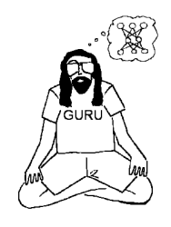



Backprop: Representations, Representations, Representations
Garrison W. Cottrell
Gary's Unbelievable Research Unit (GURU)
Computer Science and Engineering Department
Temporal Dynamics of Learning Center
Institute for Neural Computation
UCSD

Slide 2
Characteristics of perceptron learning
Supervised learning: Gave it a set of input-output examples for it to model the function (a teaching signal)
Error correction learning: only correct it when it is wrong.
Random presentation of patterns.
Slow! Learning on some patterns ruins learning on others.

Slide 3
Perceptron Learning
Learning rule:
w_{i}(t+1) = w_{i}(t) + α(t – y)x_{i} t == time, t==target
(α is the learning rate)
This is known as the delta rule because learning is based on the delta (difference) between what you did and what you should have done: δ = (teacher - output):
w_{i}(t+1) = w_{i}(t) + αδx_{i}

Slide 4
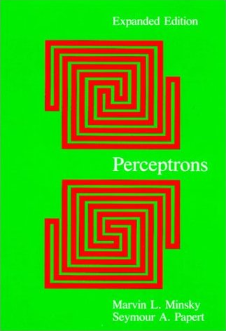
Problems with perceptrons
The learning rule comes with a great guarantee: anything a perceptron can compute, it can learn to compute.
Problem: Lots of things were not computable,
e.g., XOR (Minsky & Papert, 1969)
Minsky & Papert said:
if you had hidden units, you could compute any boolean function.
But no learning rule exists for such multilayer networks, and we don’t think one will ever be discovered.

Slide 5
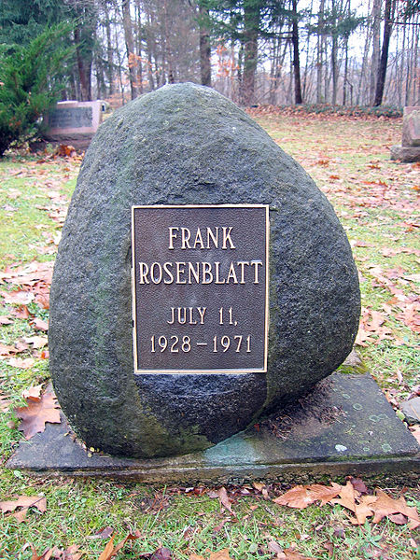
Problems with perceptrons

Slide 6
Aside about perceptrons
They didn’t have hidden units - but Rosenblatt assumed nonlinear preprocessing!
Hidden units compute features of the input
The nonlinear preprocessing is a way to choose features by hand.
Support Vector Machines essentially do this in a principled way, followed by a (highly sophisticated) perceptron learning algorithm.

Slide 7
Enter Rumelhart, Hinton, & Williams (1985)
(Re-)Discovered a learning rule for networks with hidden units.
Works a lot like the perceptron algorithm:
Randomly choose an input-output pattern
present the input, let activation propagate through the network
give the teaching signal
propagate the error back through the network (hence the name back propagation)
change the connection strengths according to the error

Slide 8
Enter Rumelhart, Hinton, & Williams (1985)
OUTPUTS
. . .
Hidden Units
Activation
Error
. . .
INPUTS
The actual algorithm uses the chain rule of calculus to go downhill in an error measure with respect to the weights
The hidden units must learn features that solve the problem

Slide 9
But first, let’s talk about forward propagation!
OUTPUTS
. . .
Hidden Units
Activation
Error
. . .
INPUTS
How does activation propagate forward in the network?

Slide 10
Start with the input pattern (e.g., MNIST pixel values)
OUTPUTS
. . .
Hidden Units
Activation
Error
x₀
x₁
x₂
. . .
x_{d}
INPUTS

Slide 11
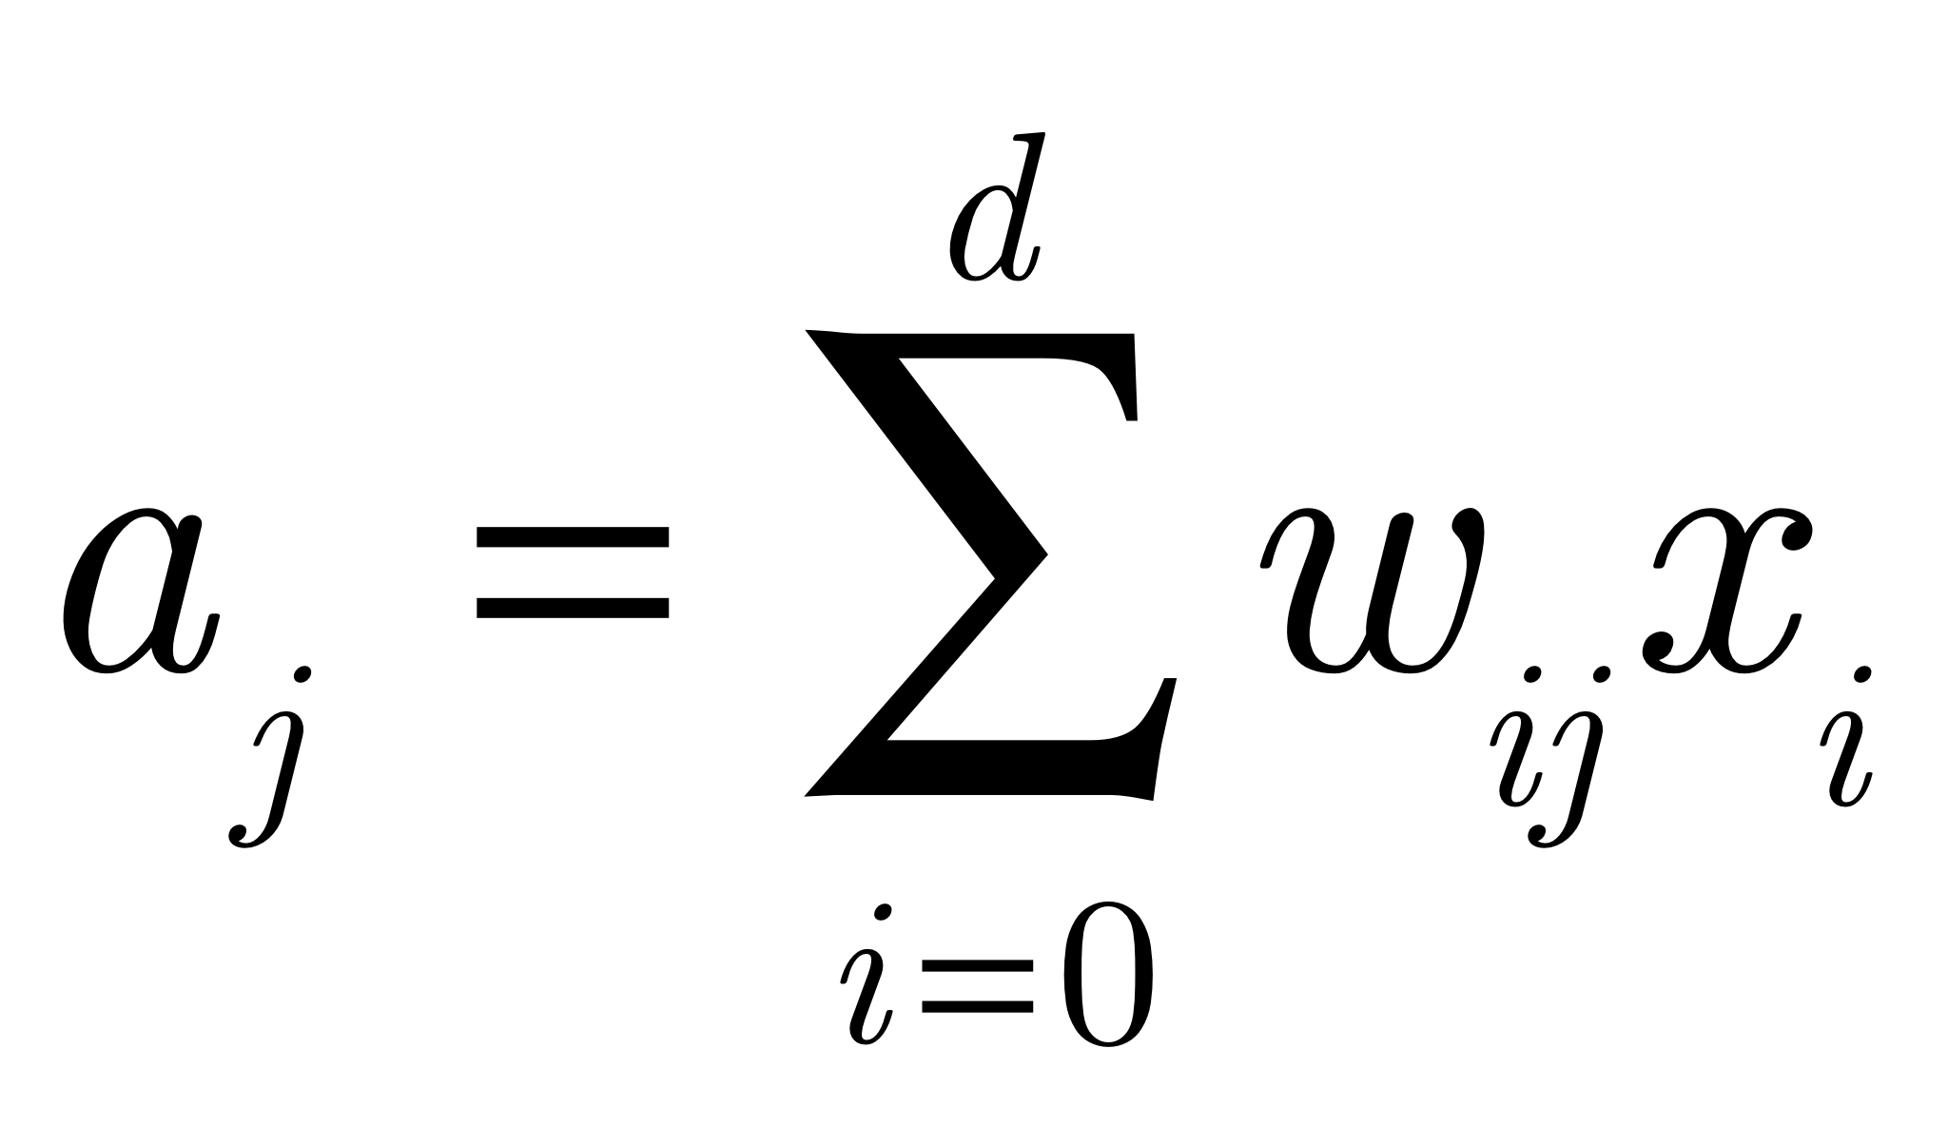
Start with the input pattern (e.g., MNIST pixel values)
OUTPUTS
. . .
Hidden Units
Activation
Error
x₀
x₁
x₂
. . .
x_{d}
INPUTS
First, compute the weighted sum of the inputs to the hidden units
Call that a_{j} as before (the net input to the hidden unit)

Slide 12
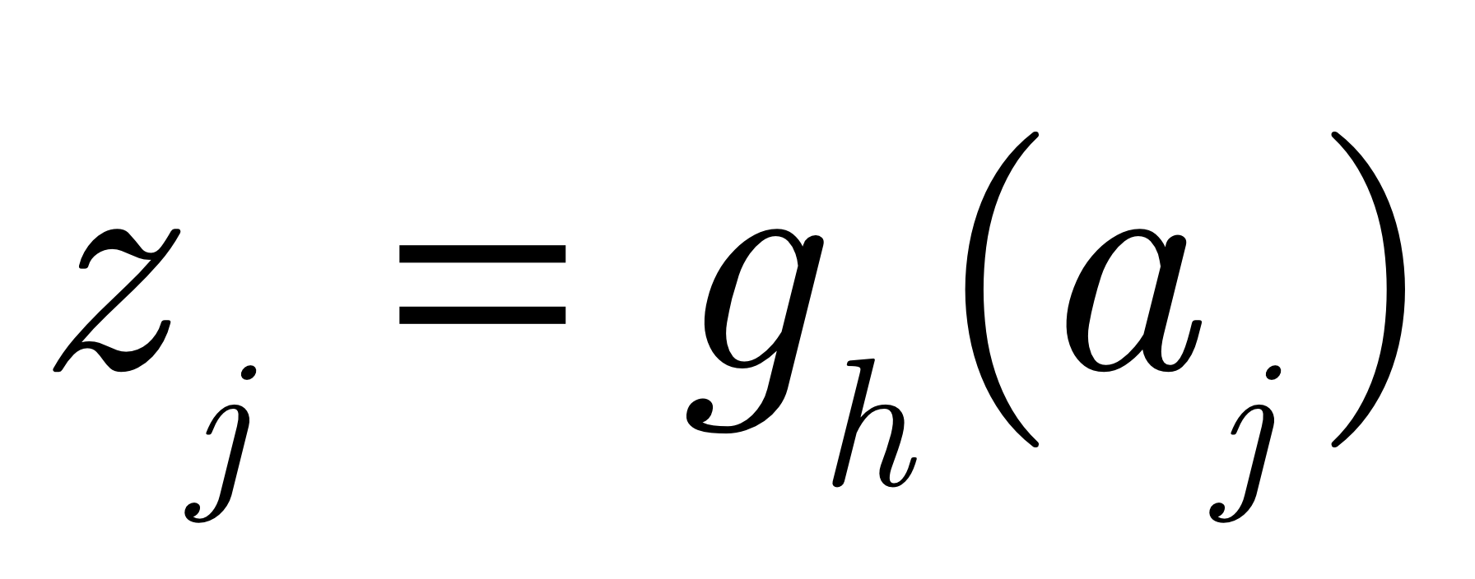
Start with the input pattern (e.g., MNIST pixel values)
OUTPUTS
. . .
Hidden Units
Activation
Error
x₀
x₁
x₂
. . .
x_{d}
INPUTS
Now, compute the nonlinear activation function of a_{j}
(could be logistic, tanh, ReLU)
z_{j} is the output of the hidden unit

Slide 13
Ok, now we have the activations of the hidden units...
OUTPUTS
. . .
Hidden Units
Activation
z₃
Error
Z₀=1
z₁
z₂
z_{M}
z₁
x₀
x₁
x₂
. . .
x_{d}
INPUTS

Slide 14
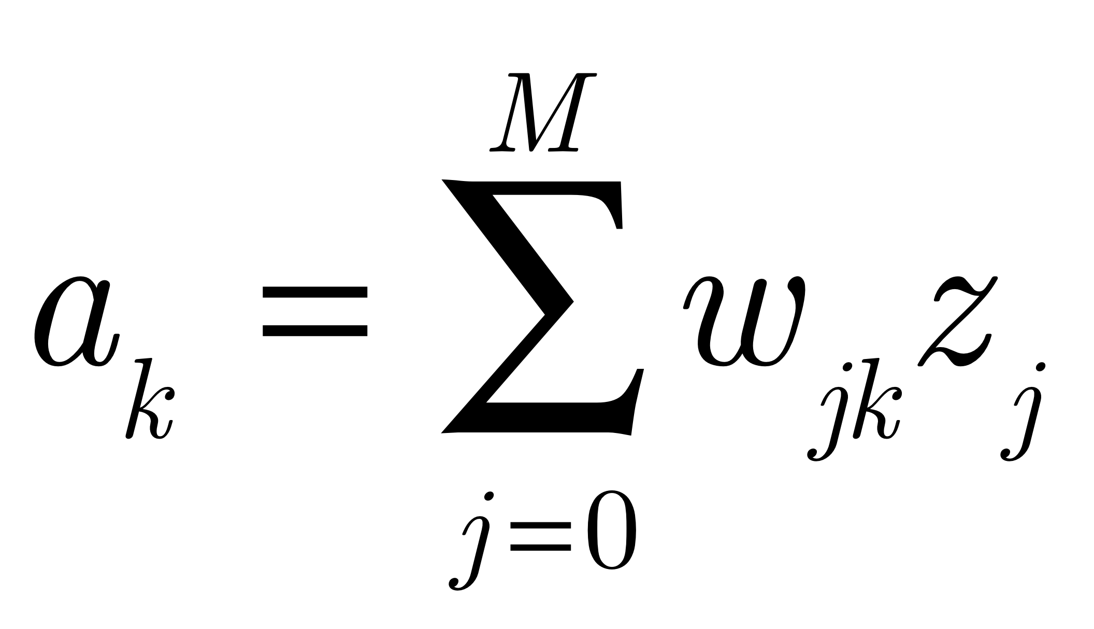
Now, compute the net input to the output units...
OUTPUTS
. . .
Hidden Units
Activation
z₃
Error
Z₀=1
z₁
z₂
z_{M}
z₁
x₀
x₁
x₂
. . .
x_{d}
INPUTS
Compute the weighted sum of the inputs to the output units
Call that a_{k} as before (the net input to the output unit)

Slide 15
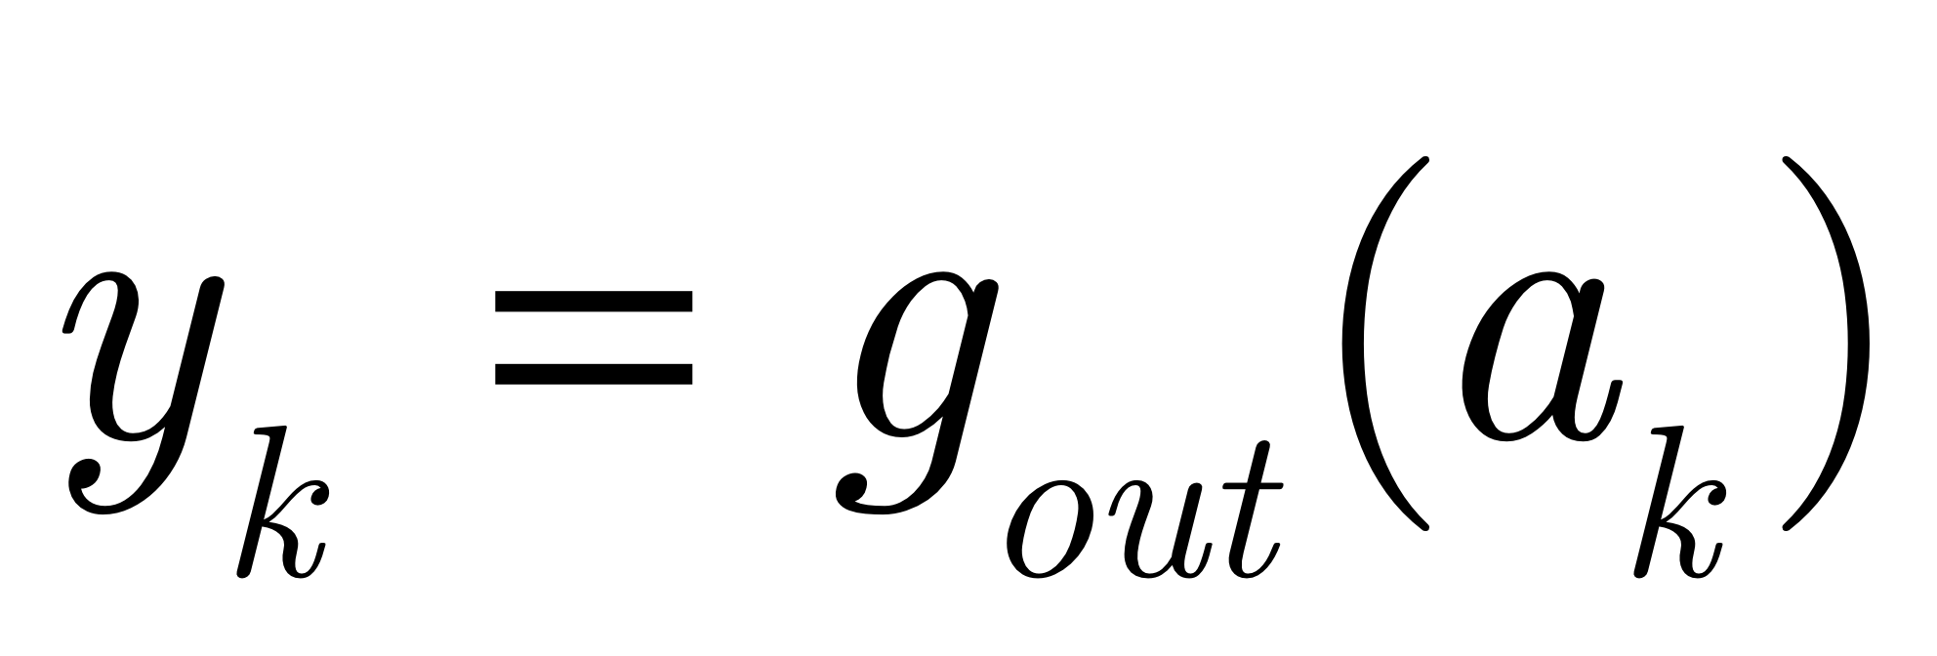
Now, compute the net input to the output units...
OUTPUTS
. . .
Hidden Units
Activation
z₃
Error
Z₀=1
z₁
z₂
z_{M}
z₁
x₀
x₁
x₂
. . .
x_{d}
INPUTS
g_{out} is the activation function of the outputs...
(softmax, linear, logistic...)

Slide 16
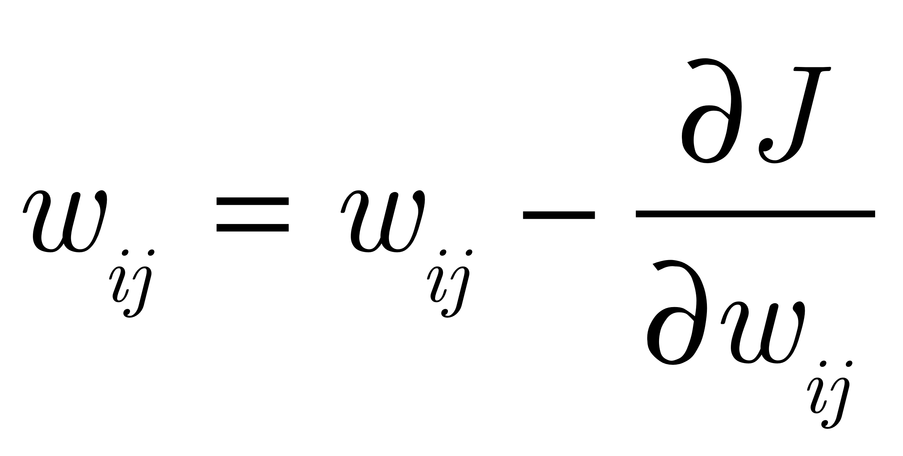
Backpropagation Learning
We will still do gradient descent:
But now, we need to take into account the hidden units!
Notation: z_{i} will mean either the output of a hidden unit, or an input.

Slide 17
The picture to have in mind:
Notation: z_{i} will mean either the output of a hidden unit, or an input.
w_{ij}
i is a
hidden unit
a_{j}
z_{i}=g(a_{i})
OR:
w_{ij}
i is an
input
z_{i}=x_{i}
a_{j}

Slide 18
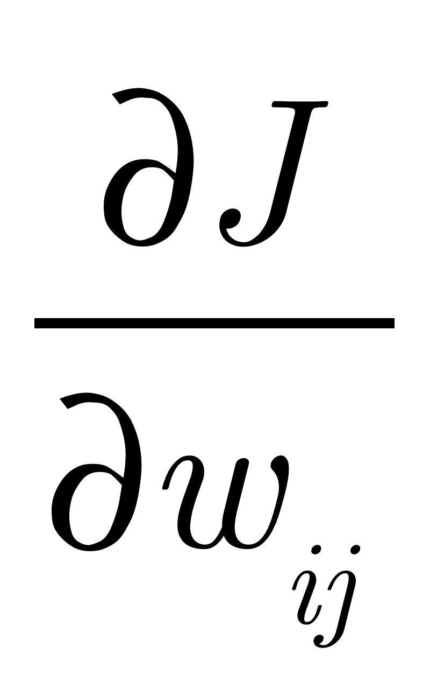
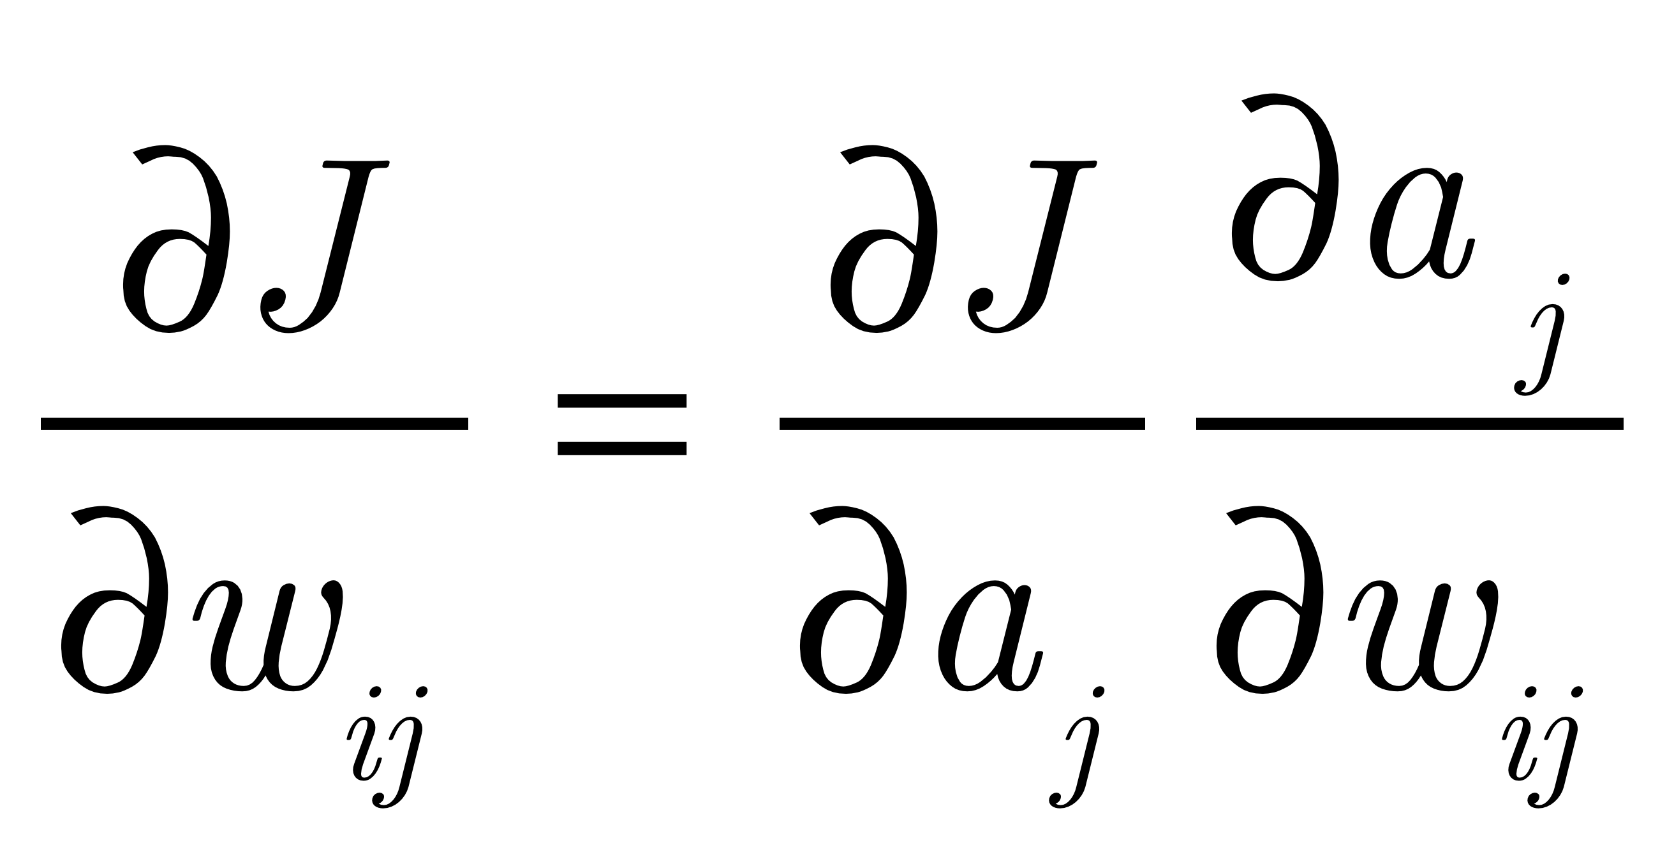
Derivation of Backprop...
J is the objective function.
We want: where w_{ij} is any weight in
the network
As usual, we start with:

Slide 19
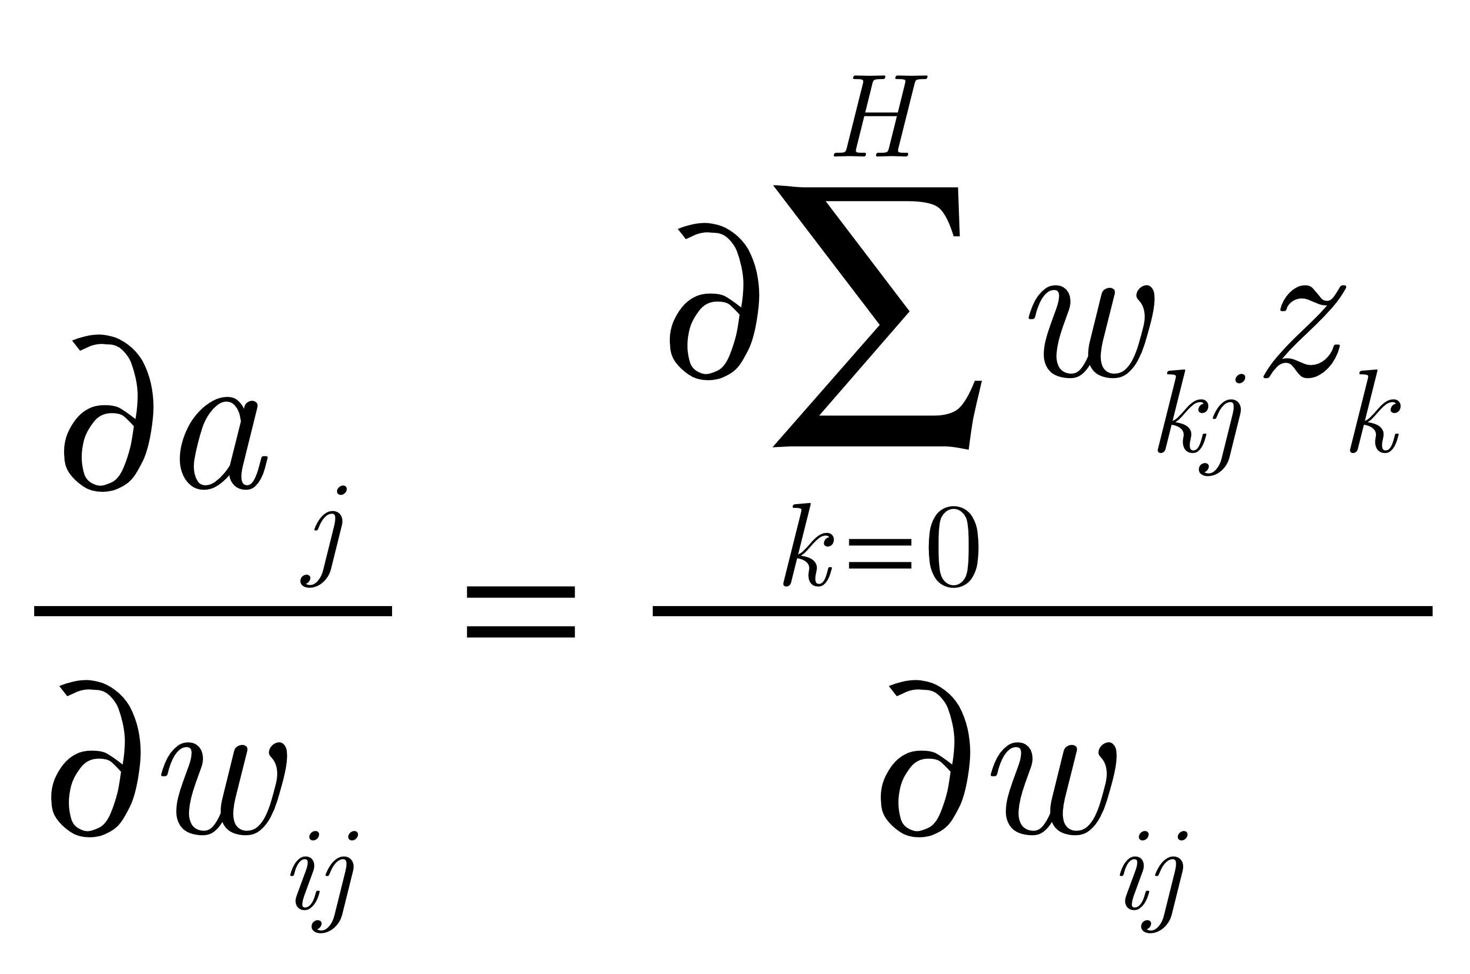
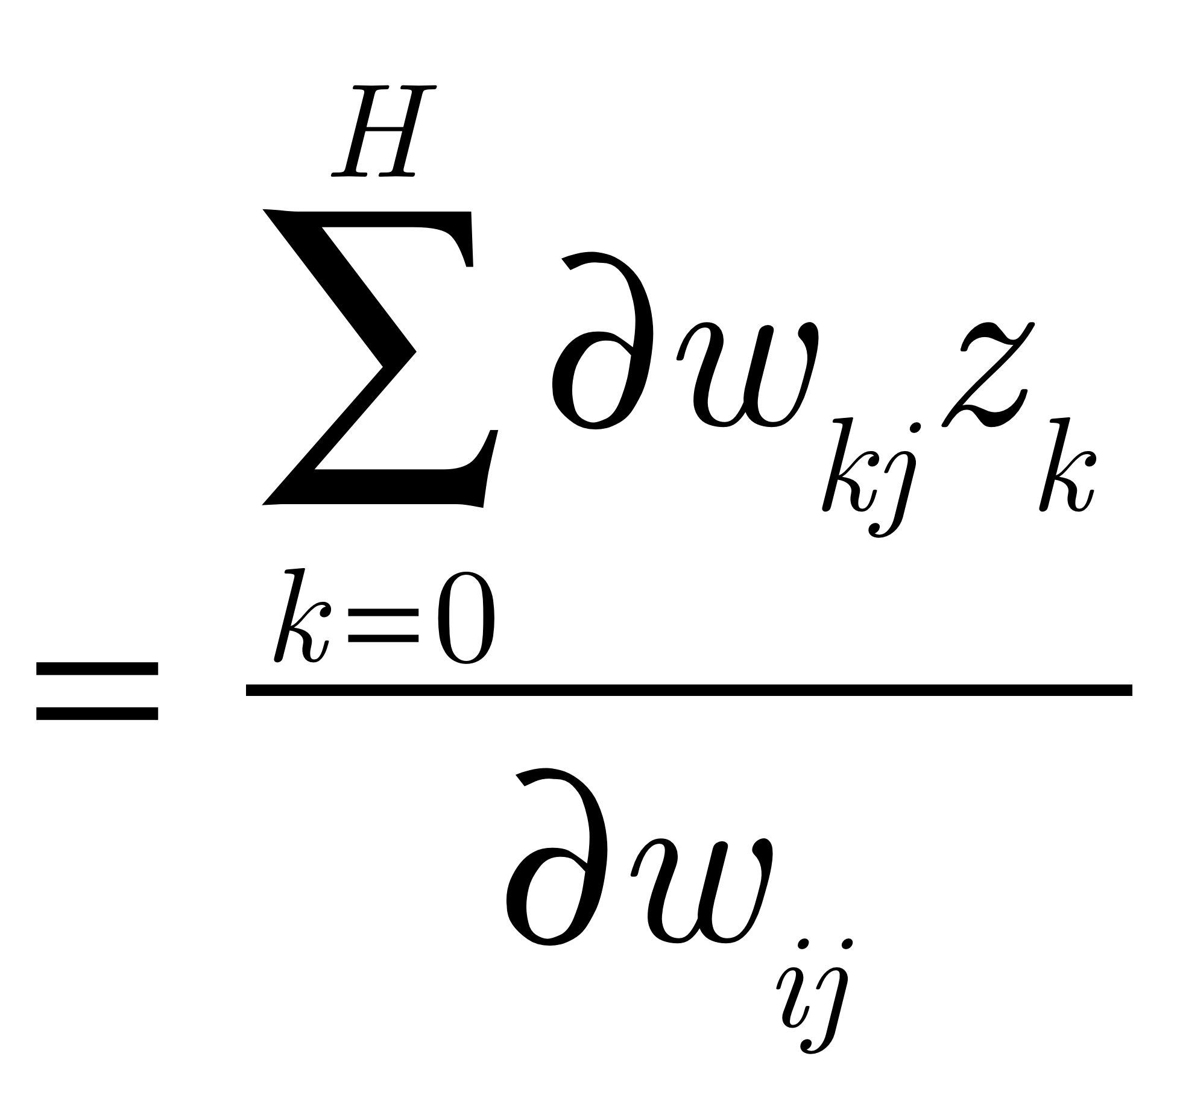
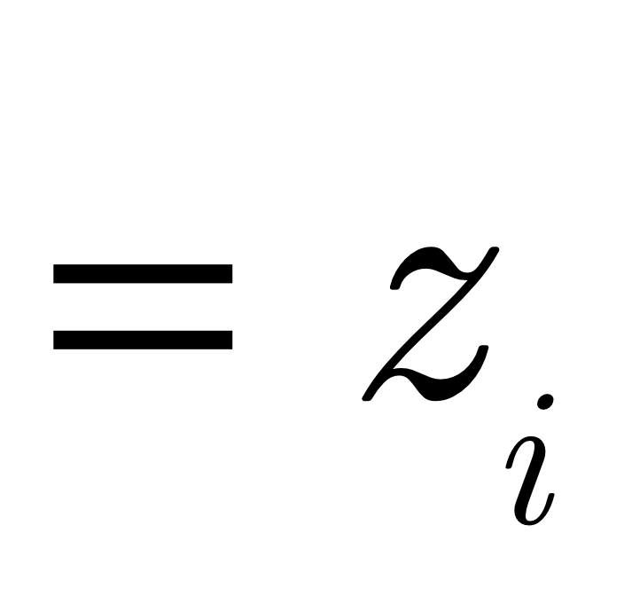
Derivation of Backprop...
Recall:

Slide 20
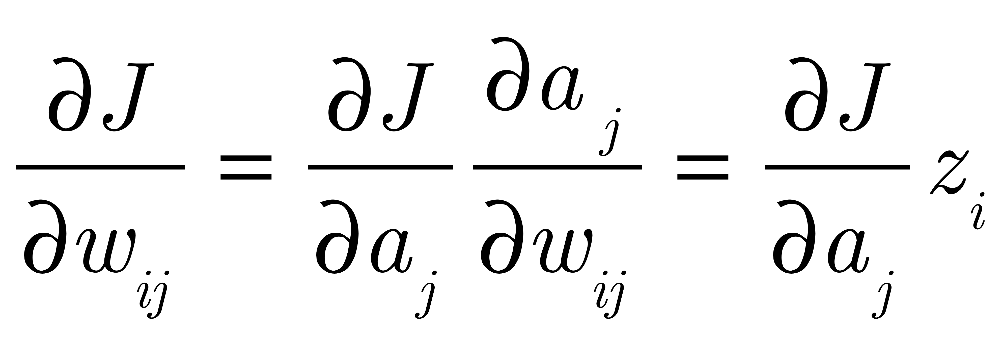
Derivation of Backprop...
So we have:
As before, we have a term that is the input on the line from i to j.

Slide 21
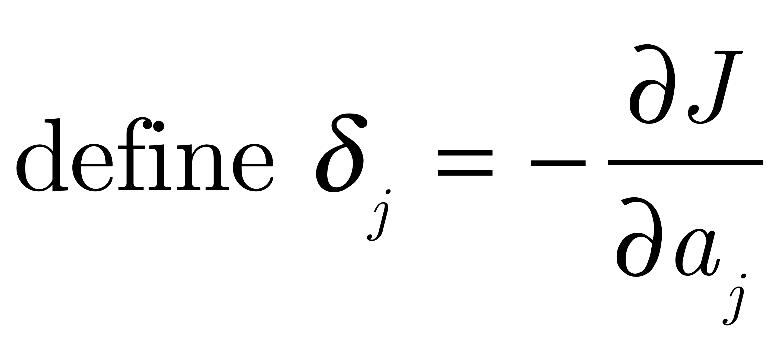
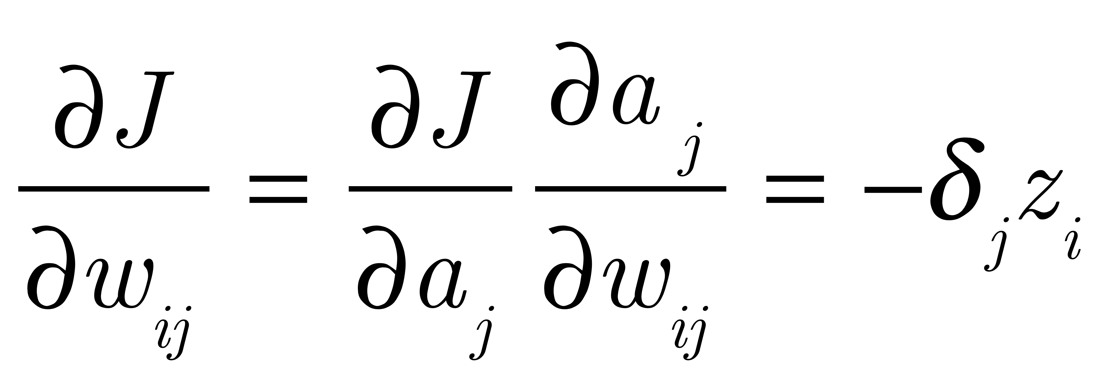
Derivation of Backprop...
Now, we define:
So we have:

Slide 22
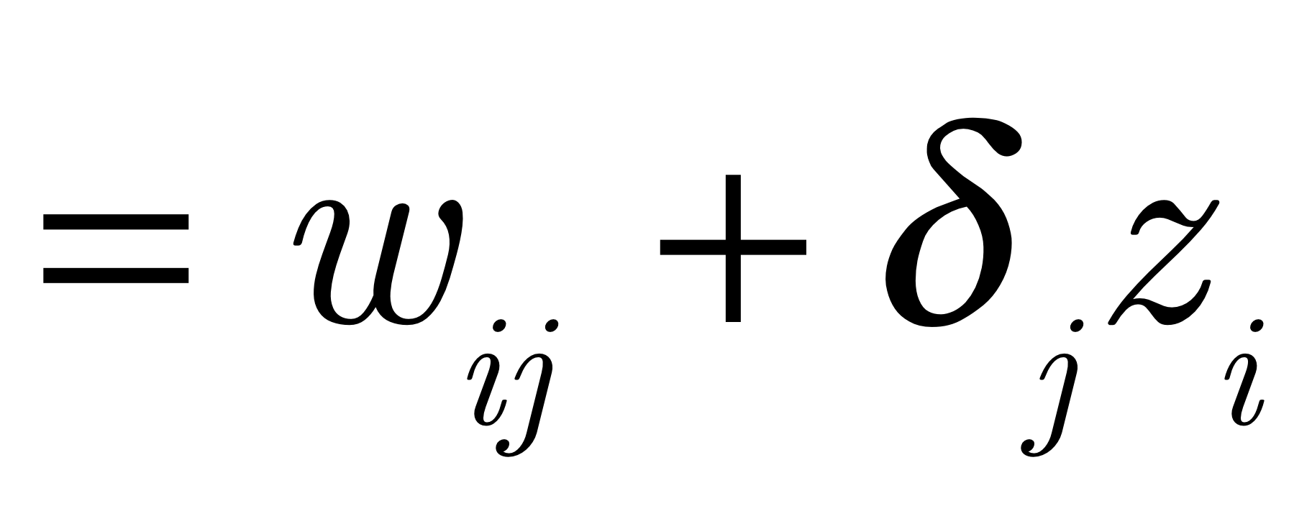
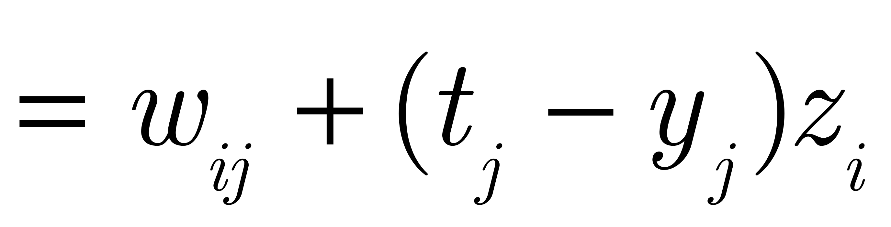
Derivation of Backprop...
Gradient descent says (ignoring the learning rate for now):
And we know for output units, this comes out to:

Slide 23
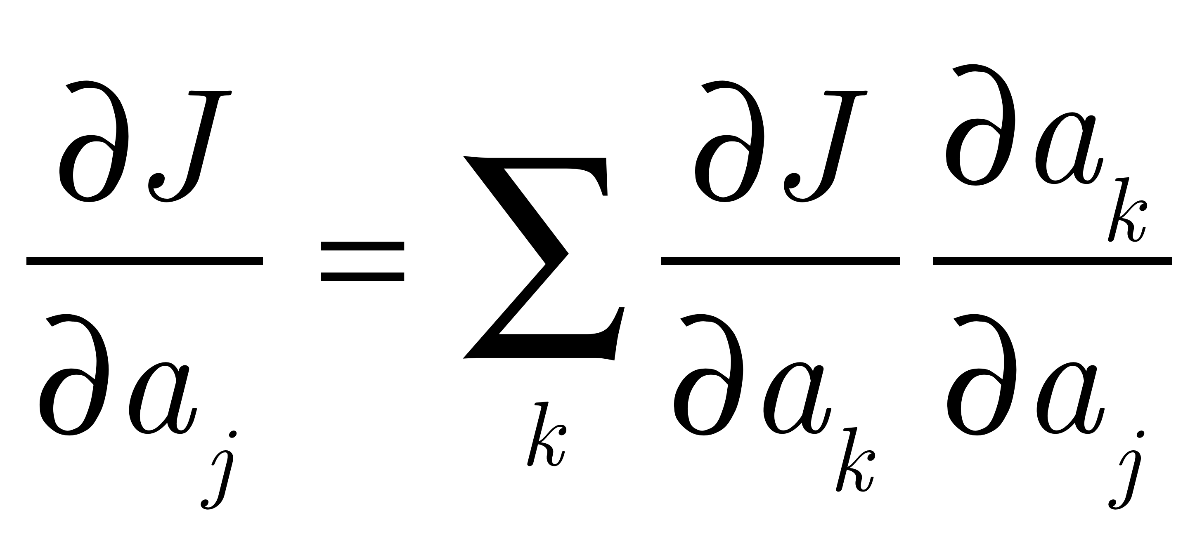
Derivation of Backprop...
For hidden units, we have to take into account every unit that unit j sends output to:
To know how changing my input changes the error, I have to know
How the error changes as the input to the units I am connected to change,
times how their input changes as my input changes

Slide 24
Derivation of Backprop...
This idea in pictures:
a_{k}
a_{k’}
a_{k’’}
a_{k’’’}
w_{jk}
w_{jk’’’}
z_{j}=g(a_{j})

Slide 25
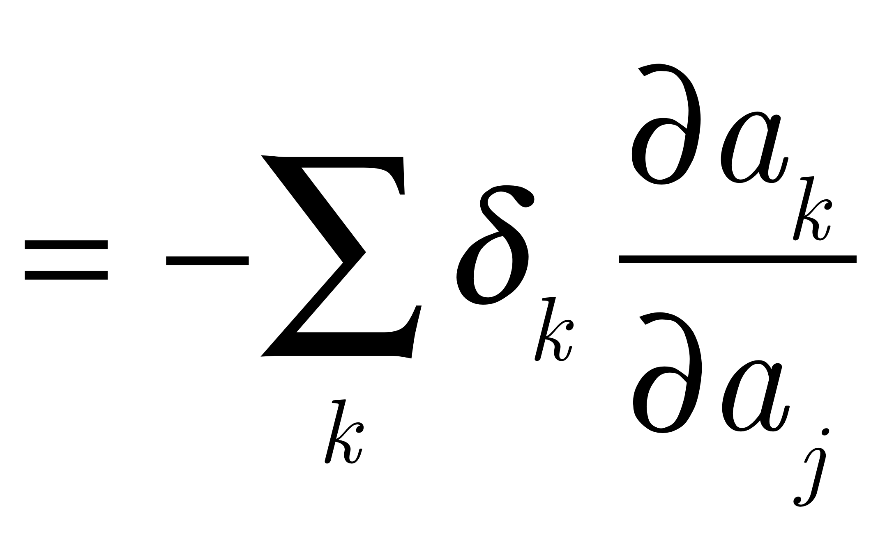
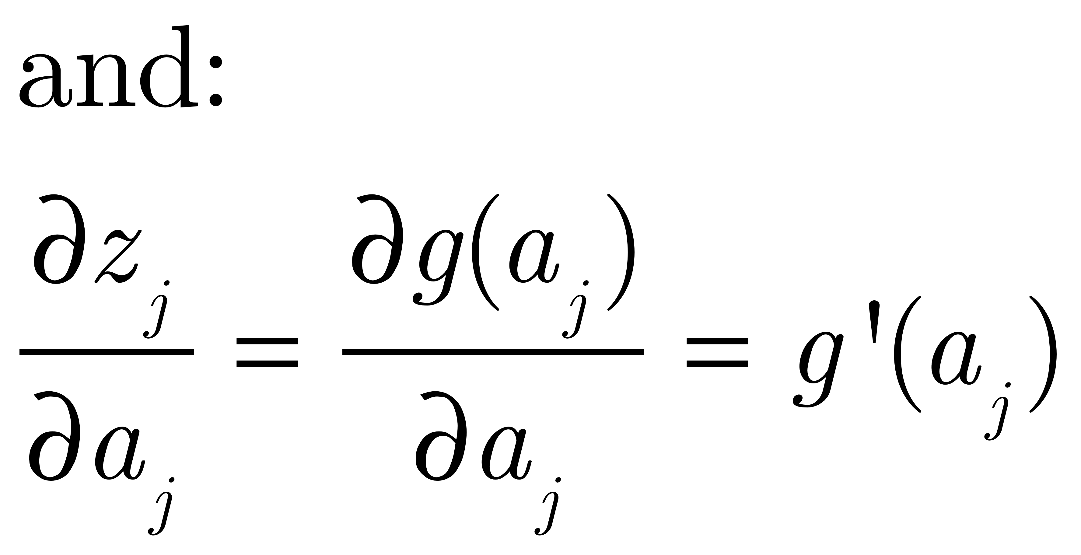
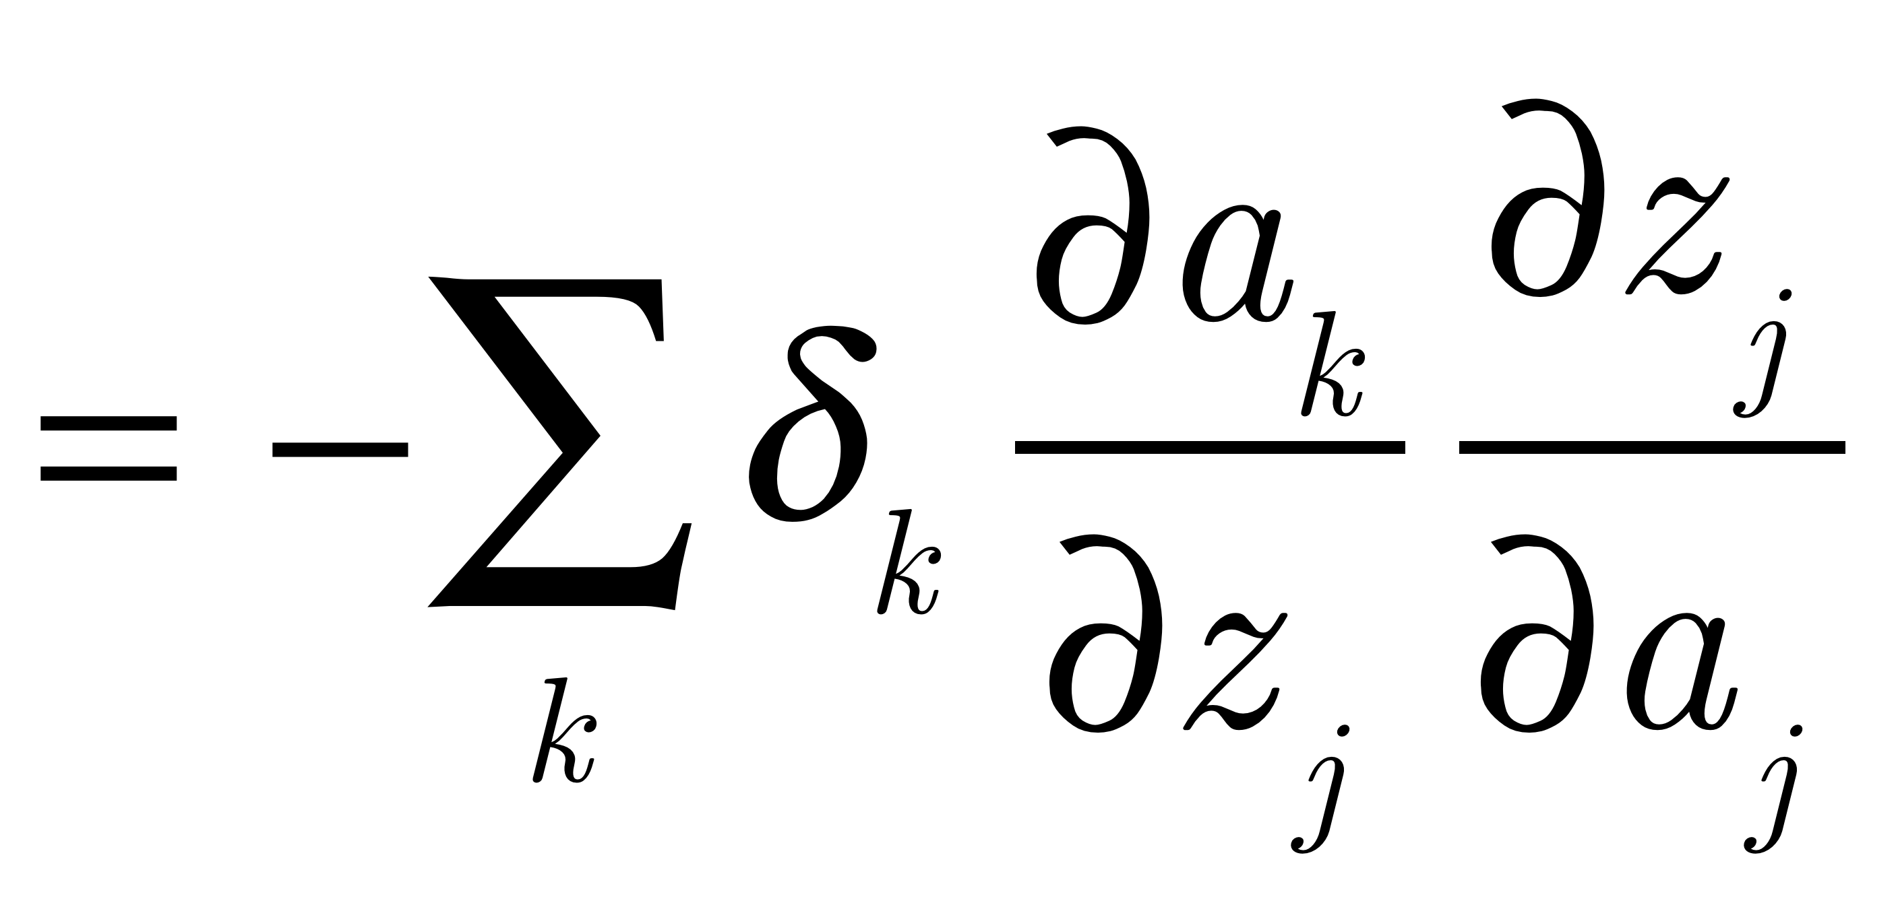
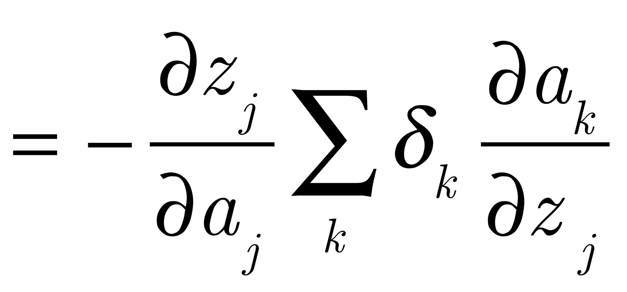
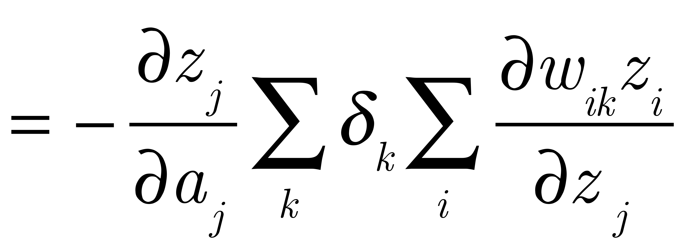
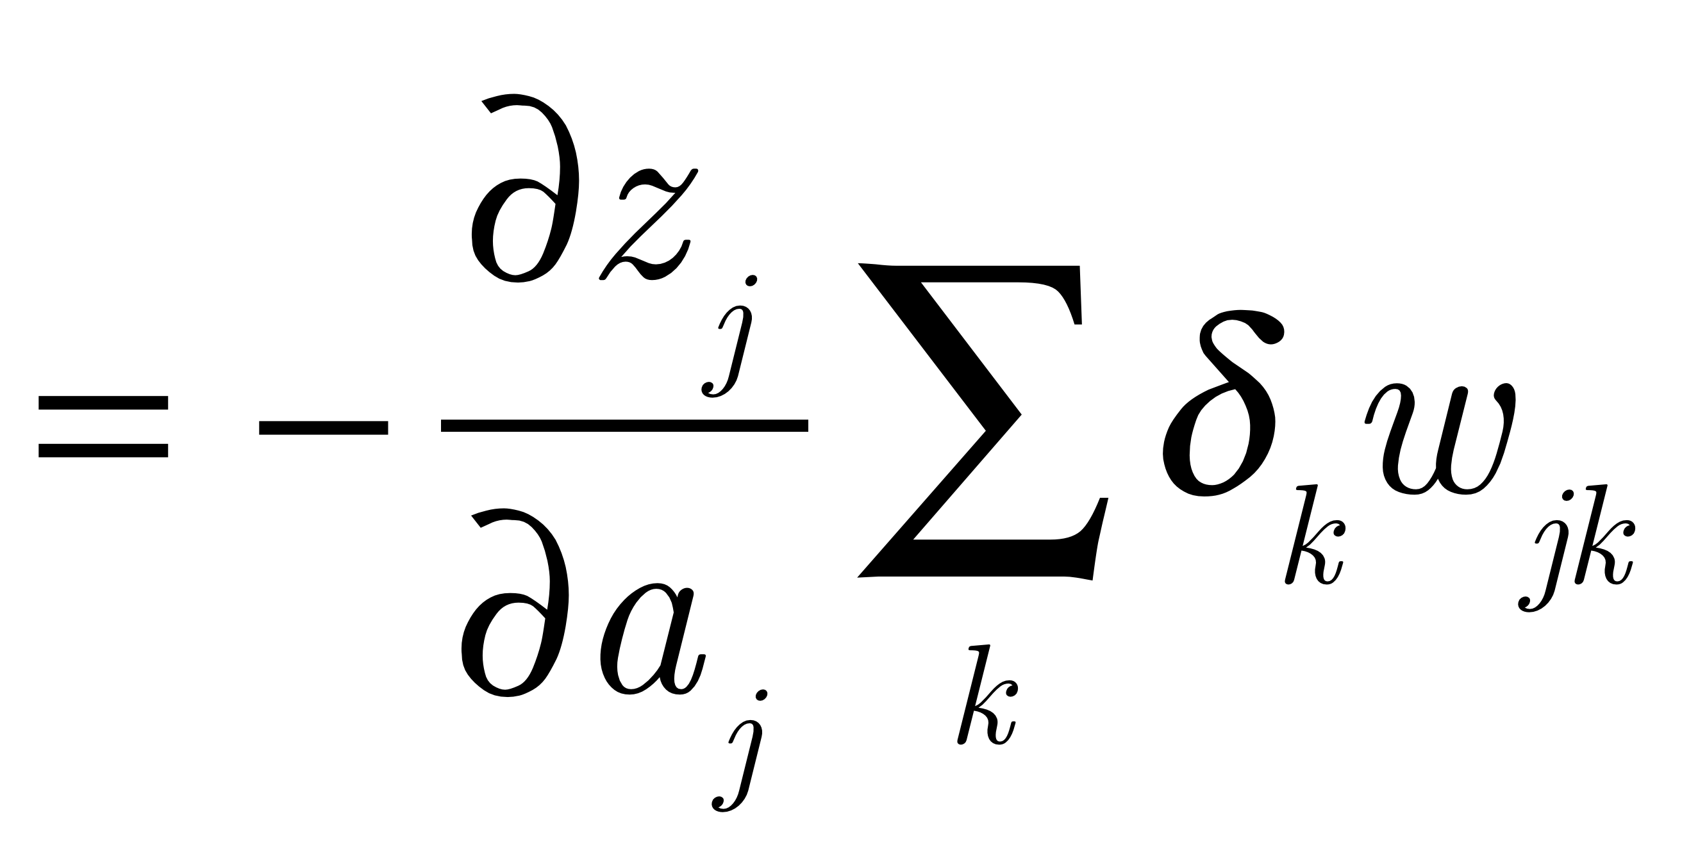
Derivation of Backprop...
Moving along:
Definition of delta
Chain rule
j is independent of k
Definition of a_{k}
Every term in the sum is 0 except when i=j

Slide 26
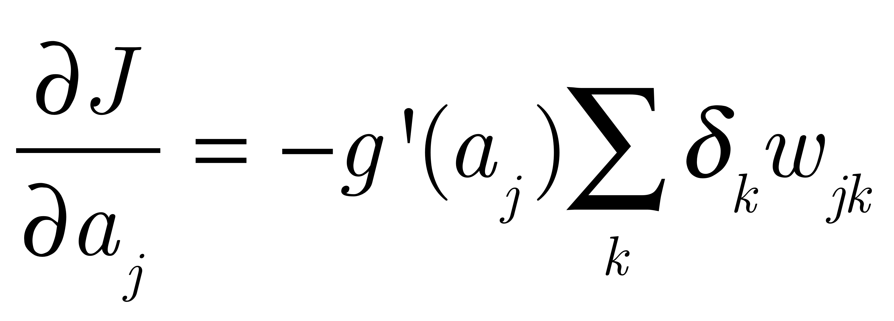
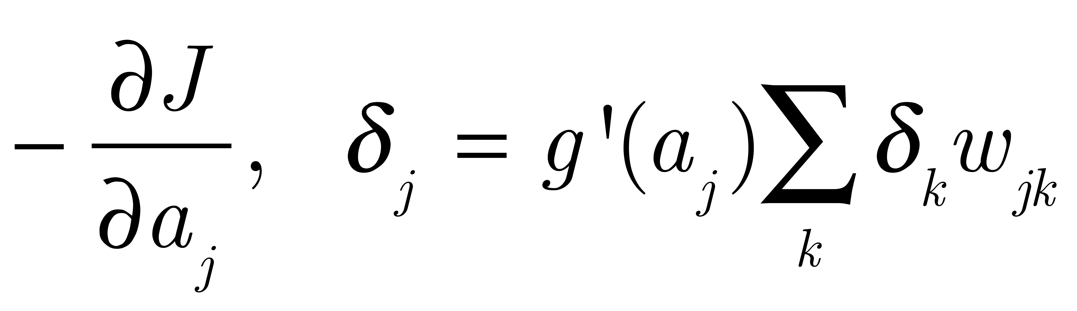
Derivation of Backprop...
SO: if j is a hidden unit
But since delta is

Slide 27
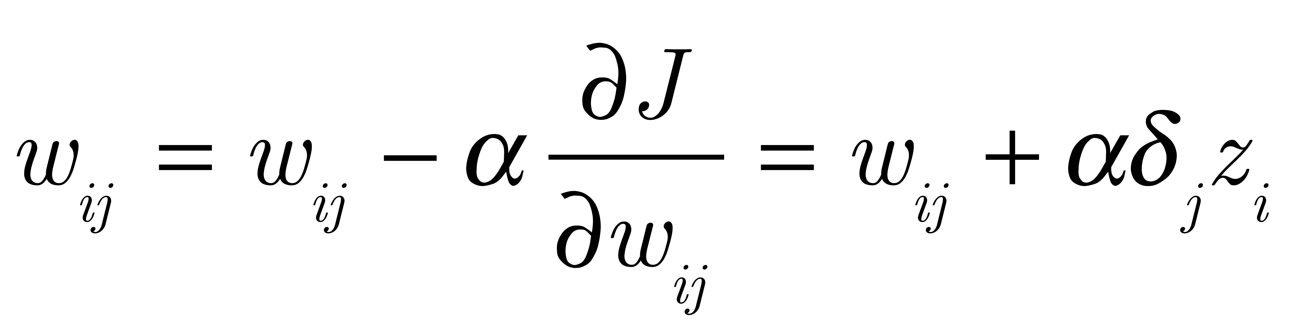
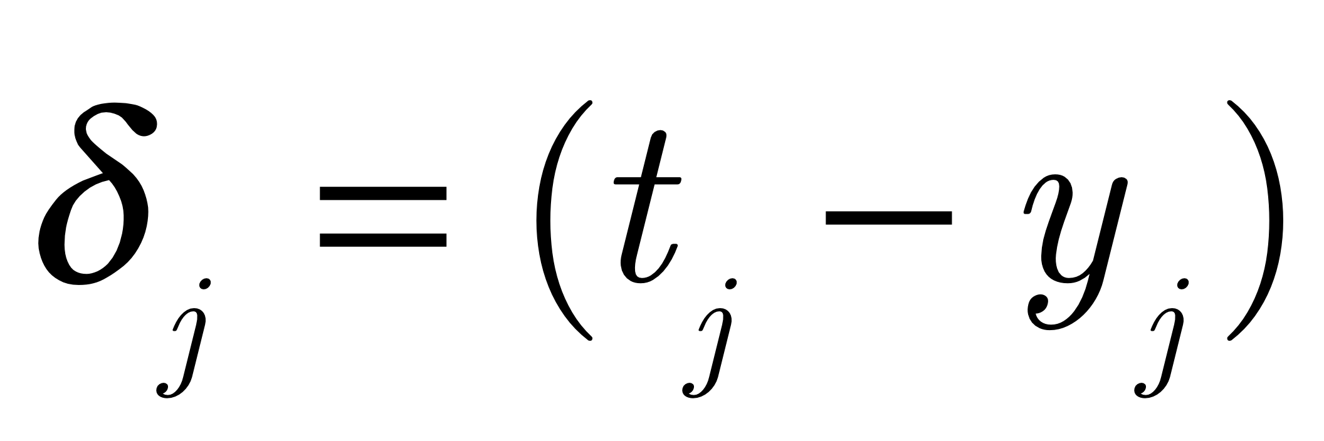
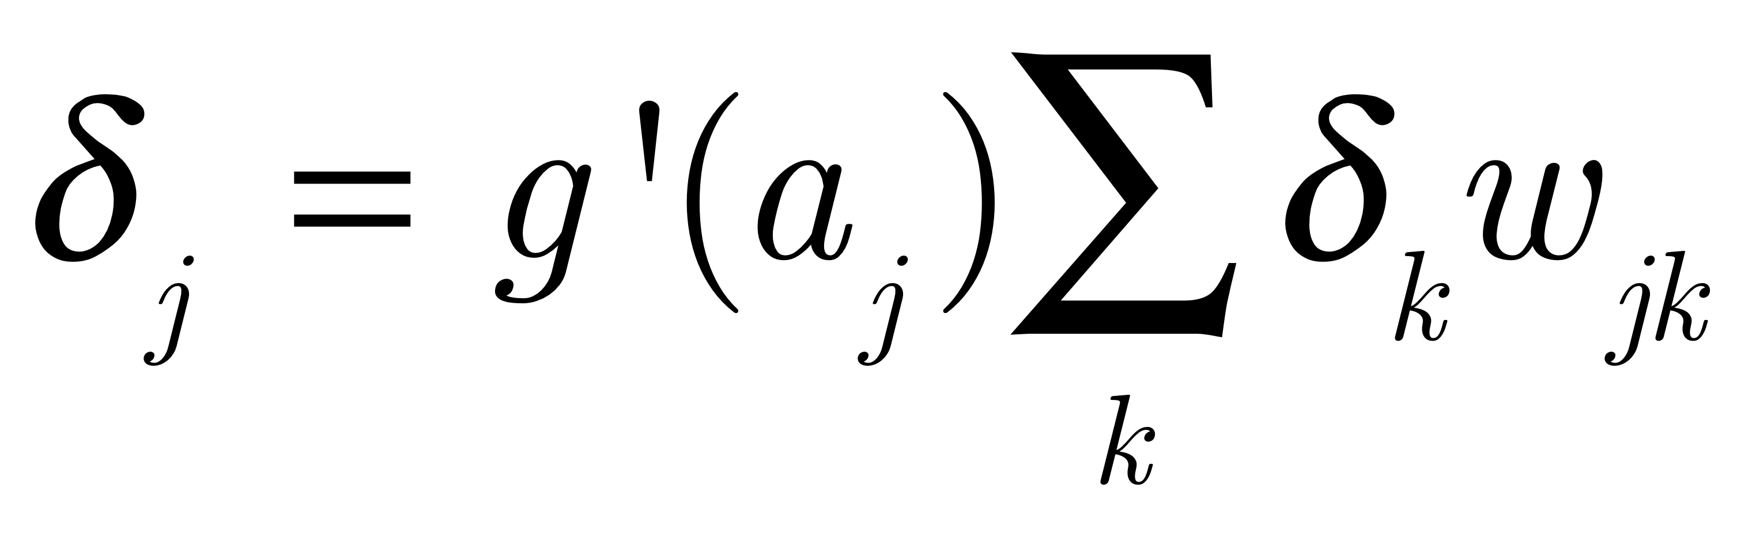
Backpropagation Learning
Learning rule:
(α is the learning rate)
Here: if j is an output unit*
if j is a hidden unit
So, we have a recursive definition of delta
*assuming the right combination of objective function and output activation function

Slide 28
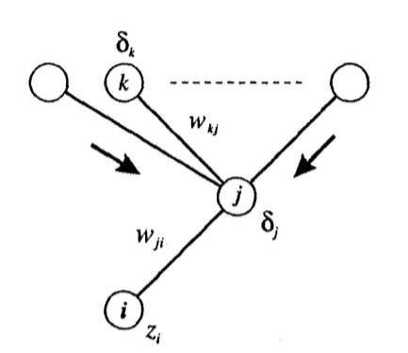
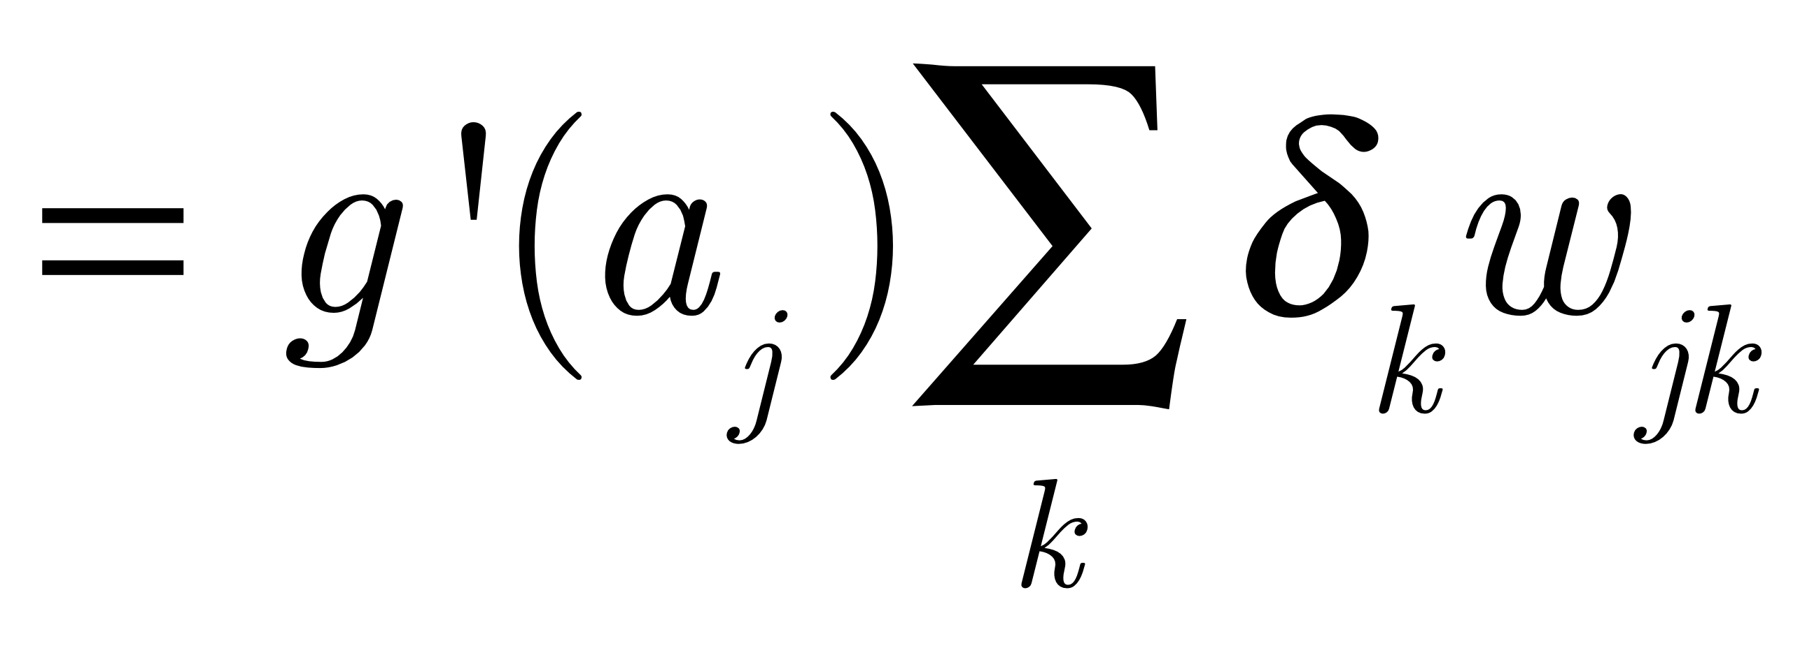
For hidden units, this is the picture to have in mind:
w_{jk}
w_{ij}
Note! You can’t get rid of the slope term for hidden units!

Slide 29
XOR
Back Propagation
Learning
OR
AND
Random Network
XOR Network
Here, the hidden units learned AND and OR - two features that when combined appropriately, can solve the problem

Slide 30
XOR
Back Propagation
Learning
OR
AND
Random Network
XOR Network
But, depending on initial conditions, there are an infinite number of ways to do XOR - backprop can surprise you with innovative solutions.

Slide 31
Clicker Questions
1. The tl;dr of backpropagation is:
It’s the opposite of forward propagation
It learns internal representations (features)
It is a form of gradient ascent
It changes the activations to go downhill in the parameters

Slide 32
Clicker Questions
1. The tl;dr of backpropagation is:
It’s the opposite of forward propagation
It learns internal representations (features)
It is a form of gradient ascent
It changes the activations to go downhill in the parameters

Slide 33
Clicker Questions
2. Computing the deltas
Starts at the output, they are propagated backwards, and the weights are changed
Starts at the output, the weights are changed, and the deltas are propagated backwards
Uses the slope of the output units
Uses the slope of the hidden units
A&D

Slide 34
Clicker Questions
2. Computing the deltas
Starts at the output, they are propagated backwards, and the weights are changed
Starts at the output, the weights are changed, and the deltas are propagated backwards
Uses the slope of the output units
Uses the slope of the hidden units
A&D

Slide 35
Why is/was this wonderful?
Learns internal representations
Learns internal representations
Learns internal representations
Efficient
Generalizes to recurrent networks

Slide 36
Representations
In the next k slides, where k is some medium-sized integer, we will look at
various representations backprop has learned, and
problems backprop has solved
The mantra here is:
Backprop learns representations in the service of the task

Slide 37
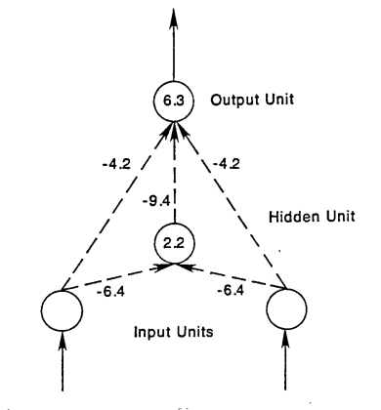
XOR
Note here that the number in the unit is the bias: so think of this as what the unit “likes to do” in the absence of any input.

Slide 38
XOR
Note here that the number in the unit is the bias: so think of this as what the unit “likes to do” in the absence of any input.
What Boolean function is the network without the hidden unit computing?
X1 | X2 | Y
0 | 0 | 1
0 | 1 | 1
1 | 0 | 1
1 | 1 | 0

Slide 39
XOR
Note here that the number in the unit is the bias: so think of this as what the unit “likes to do” in the absence of any input.
What function is the hidden unit computing?
It only turns on for (0,0)!

Slide 40
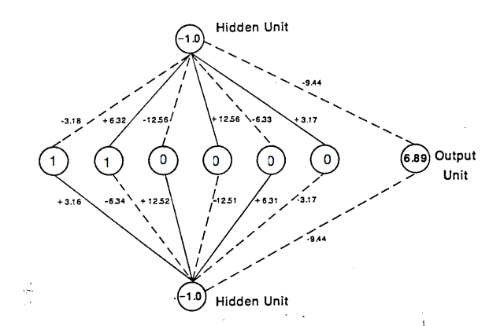
Symmetry

Slide 41
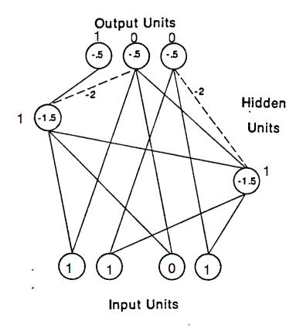
Addition
Here – think of these as binary threshold units.
Solid lines are =1
What is the hidden unit on the right doing?
The one on the left?

Slide 42
NetTalk (Sejnowski & Rosenberg, 1987)
A network that learns to read aloud from text
Trained on a corpus of 500 words, overnight on a Vax
Business Week: It learns the abilities of a six-year old child overnight! (a lot of hype…)
Maps time into space – the text is stepped through the input (a lot of alignment issues)

Slide 43
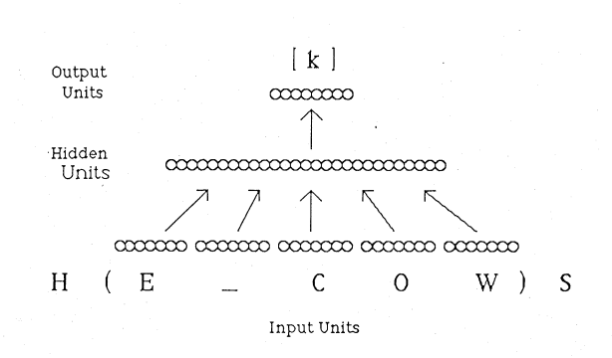
NetTalk Architecture

Slide 44


Slide 45
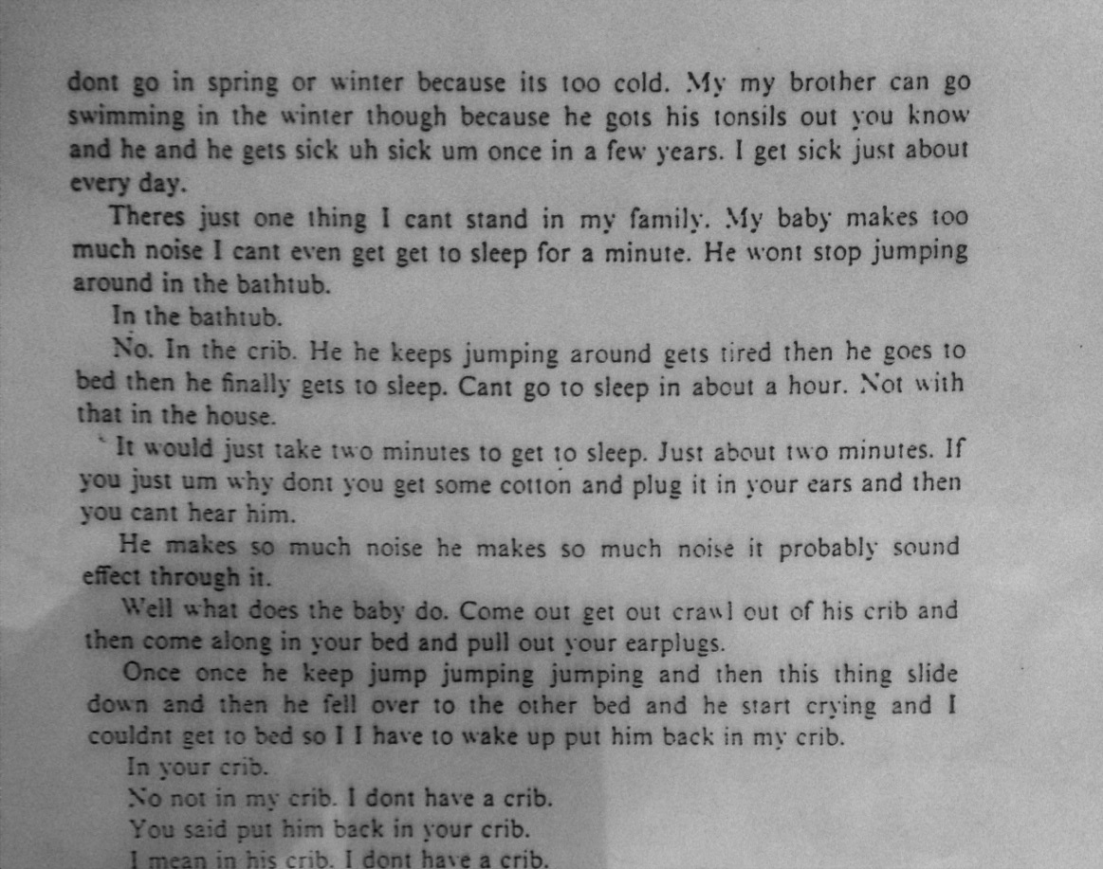
Test set

Slide 46
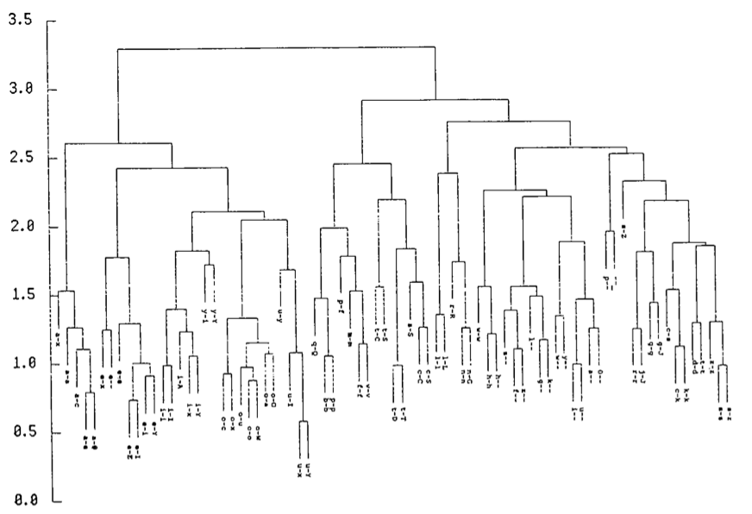
NetTalk hidden unit analysis

Slide 47
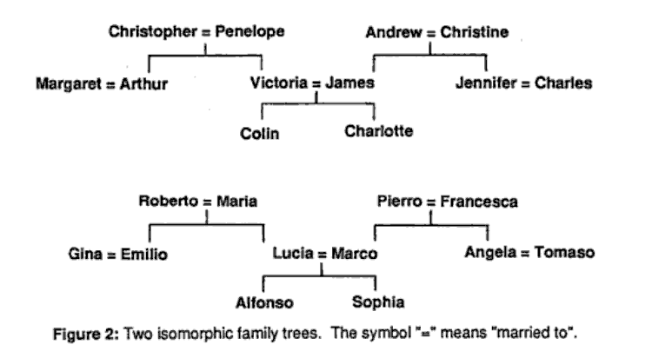
Hinton’s Family Trees example
Idea: Learn to represent relationships between people that are encoded in a family tree:

Slide 48
Hinton’s Family Trees example
Idea 2: Learn distributed representations of concepts: localist outputs
Learn: features of these
entities useful for
solving the task
Input: localist people localist relations
Localist: one unit “ON” to represent each item (AKA “one hot” encoding)

Slide 49
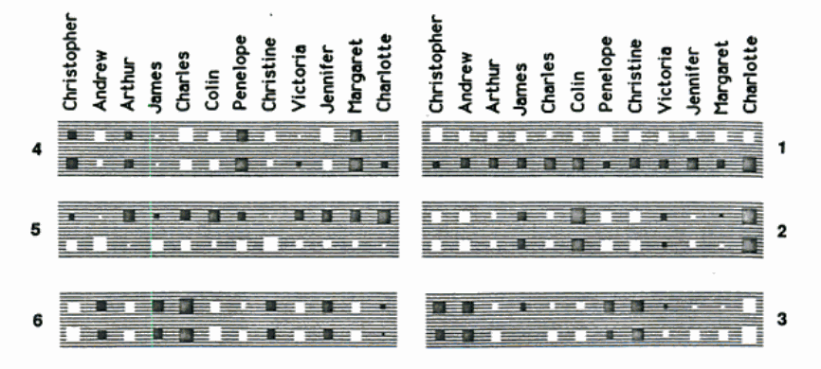
People hidden units: Hinton diagram
What does the unit 1 encode?
What is unit 1 encoding?
Notes:
Upper right: english/italian Note - unit 5 is similar and opposite

Slide 50
People hidden units: Hinton diagram
What does unit 2 encode?
What is unit 2 encoding?
Notes:
Unit 2: height in the tree

Slide 51
People hidden units: Hinton diagram
Unit 6?
What is unit 6 encoding?
Notes:
Left branch of the family; note unit 4 is opposite, roughly

Slide 52
People hidden units: Hinton diagram
When all three are on, these units pick out Christopher and Penelope: Other combinations pick out other parts of the trees
Notes:
What happens when we turn on units 1, 2, and 6?

Slide 53
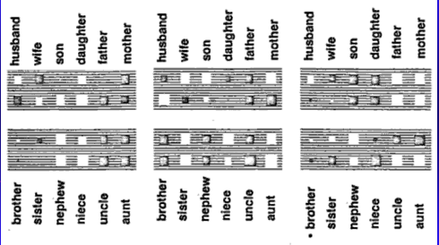
Relation units
What does the lower middle one code?
Notes:
Lower middle gender, upper right go up; lower left go down

Slide 54
Switch to Demo
This demo is downloadable from my website under “Resources”
About the middle of the page:
“A matlab neural net demo with face processing.”

Slide 55
Lessons
The network learns features in the service of the task - i.e., it learns features on its own.
This is useful if we don’t know what the features ought to be.
Can explain some human phenomena

